Slide 1
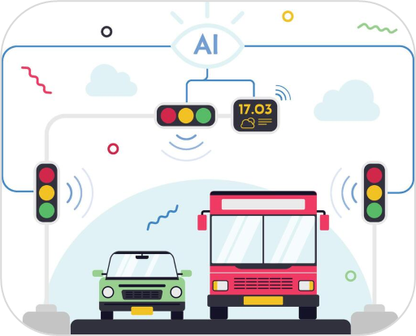
MULTI-AGENT URBAN TRAFFIC SIGNAL OPTIMIZATION IN SIMULATED ENVIRONMENTS
Project ID: 25-26J-523

Slide 2
PP2 Comments and Actions Taken
“Overall fine. Instructed to provide an expert validation of the system generated solution.”

Slide 3

Problem in Brief
Static Signal Control
No Unified Platform
No real-time adaptation [1],[4]
Cannot predict congestion [1],[4]
GNN, MPC & emergency run in silos [5]
No shared control interface [5]
Unsafe EVP Systems
Oversimplified AI Models
Green granted without safety check [2]
No downstream queue clearance [2]
Homogeneous, static graphs [6],[7]
No prediction confidence measure [8]

Slide 4
Design Excellence Over Existing Solutions
3 AI-powered components · 1 unified SUMO simulation environment · Real-time, modular, explainable
Unified Platform
Bayesian Uncertainty (GNN)
Monte Carlo Dropout UQ; automatic fallback when uncertainty exceeds threshold
Flask/React orchestrator enabling runtime hot-swapping of all three controllers
Safety-First Preemption
Predictive MPC
Decision Tree safety gatekeeper + Cascading Block; 0.27% false-negative rate
Proactive Forecasting with LSTM and Employs CASADI/IPOPT mathematical constraints

Slide 5
System Diagram
System Controlling Layer
USER LAYER
Control Panel
GNN Dashboard
MPC Dashboard
Driver Mobile App
Emergency UI
GNN-Based
Optimizer
MPC-Based
Optimizer
EVPS
AI / CONTROL
INTEGRATION
RESTful API · TraCI Interface · Scenario Manager · Data Stream Handler
SIMULATION
SUMO Simulation · Traffic Network · Signal Controllers · EV Tracking
AI Training Layer
25-26J-523

Slide 6

REAL-TIME TRAFFIC SIMULATION AND CONTROL PANEL
Research Question: How can a web-based platform enable real-time interactive control of a traffic simulation with dynamic parameter adjustment and scenario switching?
ARCHITECTURE
HOT SWAPPING
REAL TIME PARAMETER TUNING
VISUALIZATION
Flask/React full-stack with RESTful API & WebSocket telemetry
Runtime optimizer swap without restarting simulation via REST endpoints
Simulation Control Panel
Performance Dashboard
Traffic flow control
Complete Simulation Control System
IT22566898 | Sandaruwan G. D. I. | 25-26J-523

Slide 7

GNN-BASED TRAFFIC SIGNAL OPTIMIZER
Research Question: How can a heterogeneous dynamic GNN with uncertainty quantification and hybrid SSL+MARL training achieve safer network-wide signal optimization?
Graph Model
Bayesian UQ
Monte Carlo Dropout (T forward passes); fallback to deterministic controller on high variance
2-Hop Residual Heterogeneous GAT with GRU memory; lane, intersection nodes + 3 edge types
Training
Reward
SSL pre-training (100 ep) → MAPPO fine-tuning (300 ep) progressive curriculum Easy/Medium/Hard
Localized Max-Pressure + neighbor sharing for network-wide green-wave coordination
IT22591302 | Kahawaththa K. A. O. N. S. | 25-26J-523

Slide 8

MPC BASED TRAFFIC SIGNAL OPTIMIZER
Research Question: How can MPC be integrated with SUMO TraCI to predictively optimize signal timings with constraint compliance and a real-time explainable interface?
LSTM Forecaster
NPL Solver
Cost Function
Dashboard
Squares the queue lengths in the objective function to heavily penalize massive traffic jams
A real-time web interface that visually explains the MPC's decision-making
Predicts future traffic demand 15 steps into the future
Trained across diverse traffic conditions
Uses the CasADi framework and IPOPT algorithm to solve complex mathematical equations in real-time.
IT22598950 | Jayakody R.H | 25-26J-523

Slide 9
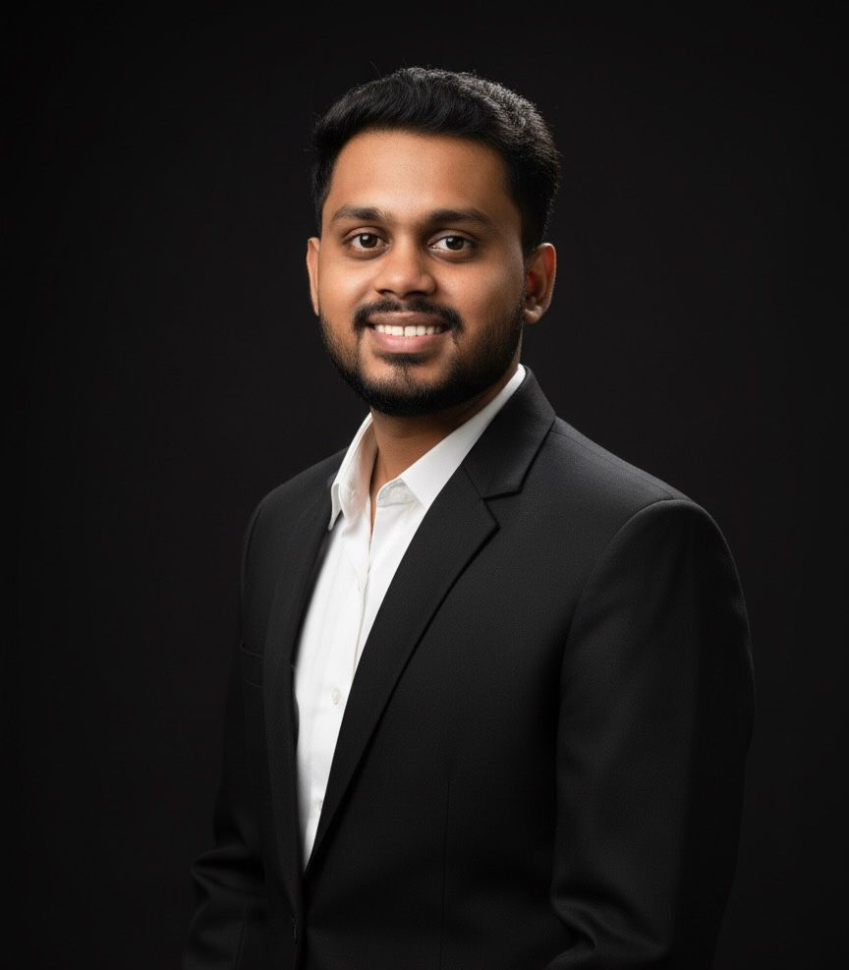
AI-DRIVEN EMERGENCY VEHICLE PREEMPTION SYSTEM (EVPS)
Research Question: How can an AI-driven EVPS proactively predict EV arrivals, ensure safe preemption, and provide real-time driver feedback in a unified framework?
LSTM ETA
SAFETY GATEKEEPER
10-timestep window; 6 features; predicts time-to-next-intersection; MAE = 0.081
Decision Tree; 10:1 asymmetric cost matrix; 97% accuracy; 0.27% false-negative rate
FLEET ARBITRATION
DRIVER FEEDBACK
Auction-house priority hierarchy; Hysteresis Lock-In; Cascading Safety Block
Flutter mobile app; real-time green-wave confirmation via WebSocket
IT22598714 | Randika D. G. T. | 25-26J-523

Slide 10
Results and Benchmark Outcomes
GNN
Waiting Time
GNN
Weighted Cost
MPC
Waiting Time
EVPS
EV Travel Time
−81.8%
−79.7%
−68.5%
−28.4%
vs. fixed-time baseline
P50 latency: 3.17 ms
3×3 grid, 300 veh/hr
High congestion; +5% max civilian delay
Component | Metric | Baseline | Our System | Δ
GNN Optimizer | Avg Waiting Time (s) | 140.06 | 25.52 | −81.8%
GNN Optimizer | Avg Queue (vehicles) | 10.35 | 3.92 | −62.2%
MPC Optimizer | Peak Waiting Time (s) | 2,700 | 1,200 | −55.6%
MPC Optimizer | Overall Waiting Time | — | — | −68.5%
EVPS | EV Travel Time (High) | 218.19 s | 156.33 s | −28.35%
EVPS | Decision Tree Accuracy | — | 97% | 0.27% FNR

Slide 11

Limitations
⚠ No real-sensor noise or physical hardware tests
⚠ limited irregular real-world topology coverage
Future Improvements
→ validate with real traffic-sensor & EV telemetry data
→ Extend training to irregular OpenStreetMap-derived topologies across diverse cities

Slide 12
MULTI-AGENT URBAN TRAFFIC SIGNAL OPTIMIZATION IN SIMULATED ENVIRONMENTS
Commercialization of the Solution
Market Opportunities
Target Market
  Reduce congestion & emissions
  Data-driven infrastructure planning
  Lower daily travel times and drastically
  Reduce emergency response times
  Municipal Traffic Authorities
  Traffic Engineers
  Urban Planners
  Emergency Services
Cost Recovery
  B2B SaaS Model
  B2C Model

Slide 13
References
[1] P. Skoropad, F. A. González, C. A. M. R. Z., and O. L. M. G., "City-Wide Traffic Signal Timing Optimization Based on Dynamic
Traffic Patterns," Sustainability, vol. 17, no. 8, p. 3383, 2025.
[2] M. S. Peelam, N. Naren, M. Gera, V. Chamola, and S. Zeadally, "A Review on Emergency Vehicle Management for Intelligent
Transportation Systems," IEEE Transactions on Intelligent Transportation Systems, pp. 1–18, 2024.
[3] M. Abdoos, N. Mozayani, and A. L. Bazzan, "Traffic light control in non-stationary environments based on multi-agent Q-learning,“
in Proc. 14th IEEE International Conference on Intelligent Transportation Systems (ITSC), 2011, pp. 1580–1585.
[4] Y. Tang and J. Duan, "Traffic Signal Control Based on Spatio-Temporal Graph Learning," Actuators, vol. 13, no. 7, Art. no. 251, 2024,
doi: 10.3390/act13070251.
[5] L. Zhang, Q. Zhao, P. Yu, J. Li, D. Yao, X. Wang, L. Wang, and L. Zhang, "Research on integrated simulation platform for urban traffic
control connecting simulation and practice," Scientific Reports, vol. 12, 2022, doi: 10.1038/s41598-022-08481-w.
[6] L. Zhao, Y. Song, C. Zhang, Y. Liu, P. Wang, T. Lin, M. Deng, and H. Li, "Temporal Graph Convolutional Network for Urban Traffic Flow
Prediction Method," arXiv:1811.05320v2.
[7] Y. Shin and Y. Yoon, "PGCN: Progressive Graph Convolutional Networks for Spatial-Temporal Traffic Forecasting,“
IEEE Transactions on Intelligent Transportation Systems, pp. 1–12, 2024.
[8] H. Li, Y. Zhao, Z. Mao, Y. Qin, Z. Xiao, J. Feng, Y. Gu, W. Ju, X. Luo, and M. Zhang, "Graph Neural Networks in Intelligent
Transportation Systems: Advances, Applications and Trends," arXiv:2401.00713v3.

